Slide 1
FY 2025 Sustainability Reporting Kick-Off

Slide 2
SPO Changes
The SPO team has be redeployed within the Office of Management.
Questions around reporting, statutory requirements, and the Dashboard can still be sent to sustainability@hq.doe.gov. The SPO team will continue to respond to reporting questions as time allows.

Slide 3
FY 2025 Reporting
Sites are required to report on statutory requirements which will include data entry and narrative components.
The Dashboard remains the system of record.
SPO has changed the name of the “Sustainability Dashboard” to the “Energy and Water Dashboard”. The URL, www.sustainabilitydashboard.doe.gov remains the same.

Slide 4
Key FY25 Reporting Dates
February 2025 – Dashboard opened for FY 2025 data entry.
October 2025 – End of year FIMS basic facility information uploaded to the Dashboard
October 23, 2025 – (Optional) FY 2025 Biobased Product Purchases Workbook uploaded within the Acquisition and Procurement narrative section of the Dashboard by sites, if needed.
November 21, 2025 – FY 2025 Dashboard data, including (optional) Sustainable Acquisition Contracts workbook, are due with appropriate level(s) of approval. If not using the Dashboard, approval process be sure to upload a completed Dashboard Data Accuracy Self-Certification. For 2025 narrative, Excluded Building Self Certification, and optional Plan Signature Document are due with appropriate level(s) of approval
While the data and narratives are due FY 2026, both the data and the narrative should capture the FY 2025 reporting period. The FY 2026 Energy and Water Narrative Instructions are titled accordingly with the FY 2026 narrative submission due date.

Slide 5
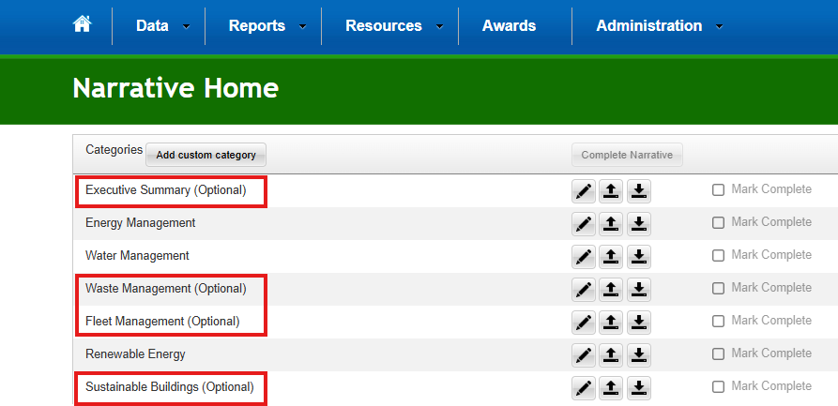
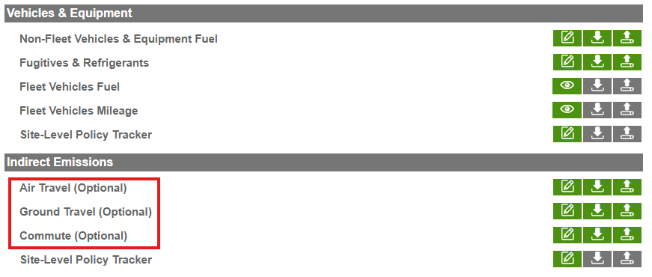
Dashboard Updates
Renaming
The “Sustainability Dashboard” is now named the “Energy and Water Dashboard”
The “Site Sustainability Plan” or “SSP” is now named the “Narrative”.
Differentiated between optional and required reporting and narrative categories.
Removed irrelevant data fields within Energy, Facility Goal Category, Metering (e.g., CFE, FBPS, electrification) reporting categories.
Removed irrelevant data tables within the narrative category.

Slide 6
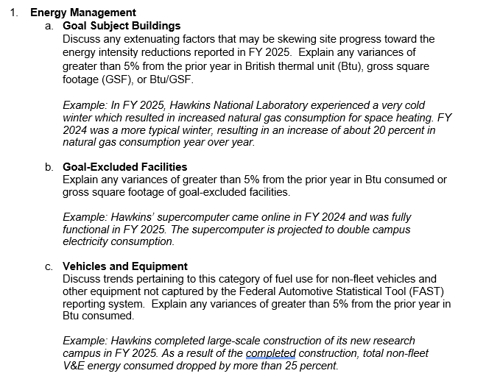
FY 2026 Energy & Water Narrative Instructions
FY 2026 Instructions focus on information needed to complete statutory reporting.
Sites are only required to fill out Energy Management, Water Management, and Renewable Energy narrative sections if the reported year over year data fluctuates by more than ±5%.
Sites are only required to fill out the Investments: Facilities and Workforce narrative if they have a relevant project.
The narrative is due to the Dashboard within corresponding section of the narrative module.
Narrative requirements for Executive Summary, Waste Management, Fleet Management, Sustainable Buildings, Acquisition & Procurement, Indirect Emissions, Fugitives & Refrigerants, Electronic Stewardship & Data Centers, and Adaptation & Resilience are optional

Slide 7
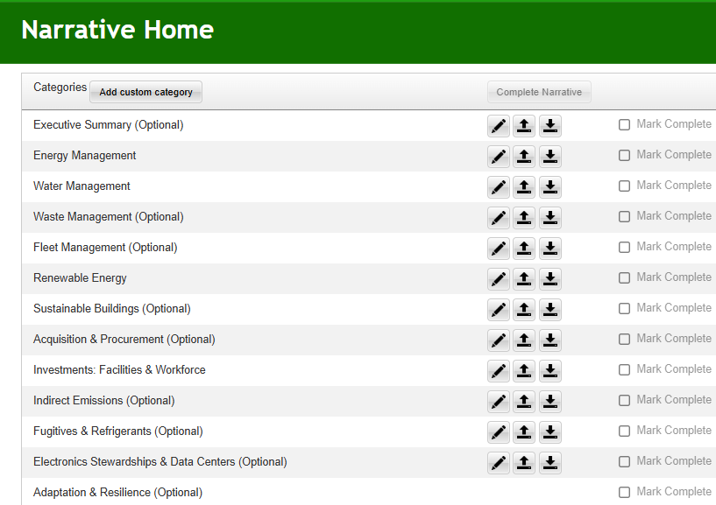
Optional Energy and Water Narrative Sections
The following sections are “optional” for Energy and Water Management Narrative reporting and have been indicated as such in the narrative section of the Dashboard:
Executive Summary
Waste Management
Fleet Management
Sustainable Buildings
Acquisition & Procurement Narrative (Optional workbooks should still be uploaded to this page, if submitted)
Indirect Emissions
Fugitives & Refrigerants
Electronic Stewardship & Data Centers
Adaptation & Resilience

Slide 8
Completing the Narrative
Once you have checked the “Marked Complete” box for each narrative category, select the “Complete Narrative” button. If you have the responsibility for approval, you will then have the option to “approve” or “reject” the narrative (on the right-hand side). The narrative can also be approved via the Completion Status page and should have all levels of approval like the Dashboard data.
Note that The Dashboard is currently being modified so only Energy, Water, Renewable Energy, and Investments: Facilities and Workforce categories need to be marked as complete before completing the entire narrative.

Slide 9
Supporting Resources
Users are encouraged to browse the Supporting Resources Dashboard section to assist with reporting.
The Reporting Files section includes:
Biobased and Sustainability Acquisition Contracts Workbooks
A Requirements Matrix, Reporting Requirements Crosswalk, and Energy and Water Goals Table to assist in understanding goals and requirements.
The Training Files section includes:
Short tutorial videos (e.g., Narrative, QC/QC, Change Requests) on submitting data and the narrative. Please note that some resources such as the Site Sustainability Plan Module have not been updated to reflect recent narrative name changes and optional reporting categories.

