Slide 1
FY 2025 Sustainability Reporting Kick-Off
Sustainability Performance Office
September 17, 2024

Slide 2
Recording message
This Teams call is being recorded and may be posted on DOE's website or used internally. If you do not wish to have your voice recorded, please do not speak during the call. If you do not wish to have your image recorded, please turn off your camera or participate by phone. If you speak during the call or use a video connection, you are presumed consent to recording and use of your voice or image.

Slide 3
Agenda
Key Reporting Dates
Schedules
New User Guide and Log in Process
Approvals and user access updates
FY 2025 Site Sustainability Instructions
Reporting Changes by SSP Category
Dashboard Updates
Schedules
Resources

Slide 4
Key Reporting Dates
September 24, 2024 – Dashboard new user training
September 26, 2024 – Sustainability data verification training
October 1 – December 3, 2024 – Open Help Calls every Tuesday from 3-4 pm EST
October 23, 2024 – Sustainable Buildings module will be locked + Biobased Product Purchases workbook* due via upload to SSP module
November 22, 2024 – Sustainability data direct entry into Dashboard + Sustainable Acquisition Contracts* due via upload to SSP module
December 6, 2024 – SSP narrative due via direct entry in Dashboard + Excluded Building Self-Certification
*Note, Biobased Product Purchases and Sustainable Acquisition Contracts workbooks are only necessary if the site cannot report in SAM and FPDS, respectively.

Slide 5
FY 2025 Reporting Schedule
Date(s) | Action/Event
February 2024 | Dashboard opened for FY 2024 data entry.
September 24, 2024 | Dashboard new user training.
October 1 to December 3, 2024 | Weekly Open Line Help Call for FY 2024 sustainability reporting every Tuesday from 3 - 4pm EST. See Dashboard for call-in details.
October 2024 | End of year FIMS basic facility information uploaded to Dashboard.
October 23, 2024 | Sustainable Building page locked for data entry until February 2023. All updates must be completed before Oct. 23^{rd.} FY 2024 Biobased Product Purchases Workbook uploaded to Dashboard, if needed.
November 22, 2024 | FY 2024 Dashboard data, including Sustainable Acquisition Contracts (if needed) is due with appropriate level(s) of approval. If not using the Dashboard approval process, be sure to upload a completed Dashboard Data Accuracy Self-Certification. Final FY 2024 Federal employee travel data uploaded to Dashboard.
November 22 to December 13, 2024 | SPO to QA/QC data and work with sites to finalize FY 2024.
December 6, 2024 | FY 2025 SSP narrative, Excluded Buildings Self-Certification, and optional Plan Signature Document are due with appropriate level(s) of approval. Dashboard closes for FY 2024 SSP entry.
January 17, 2025 | Deadline for selected sites to submit verification documentation.
February 2, 2025 | Final FY 2024 fleet data uploaded to Dashboard.

Slide 6
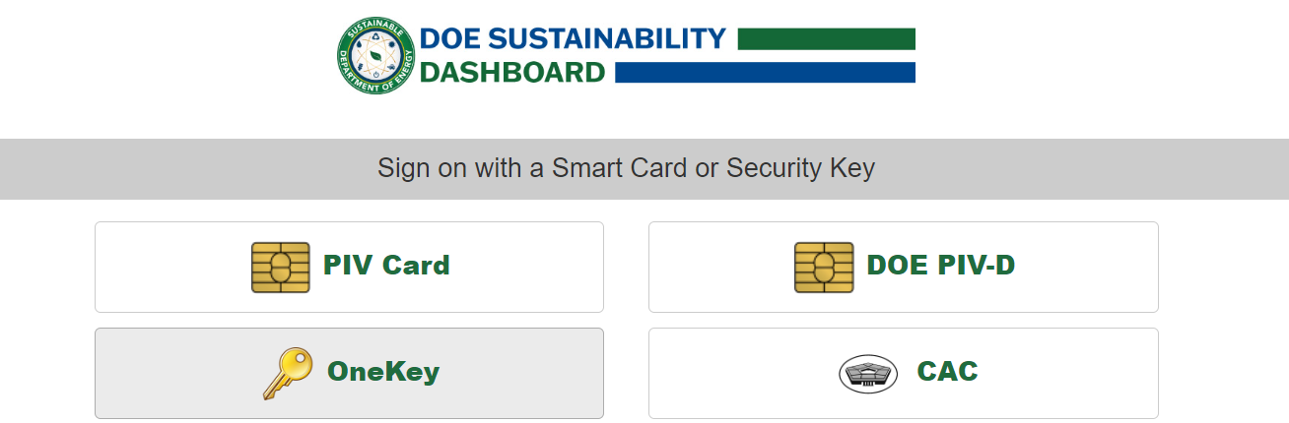
Dashboard Updates – Login Changes
Users will notice a new process for signing into the DOE Sustainability Dashboard. Users will no longer be able to log in using an email address and password. All users will be required to use either a Personal Identity Verification (PIV) card (e.g., HSPD-12 badge) OR log-in with a Login.gov or ID.me account to access the system.
If you need help creating a Login.gov account, please email sustainability@hq.doe.gov.

Slide 7
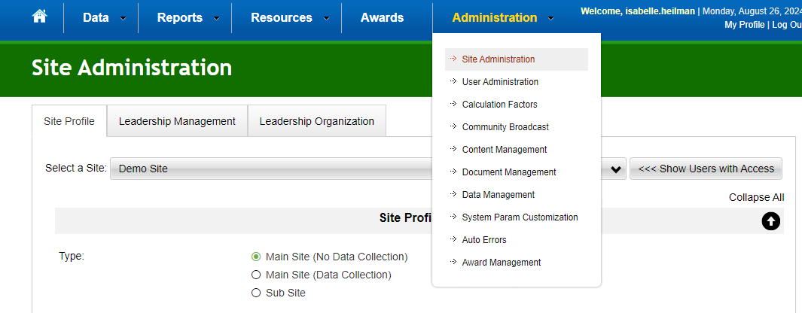
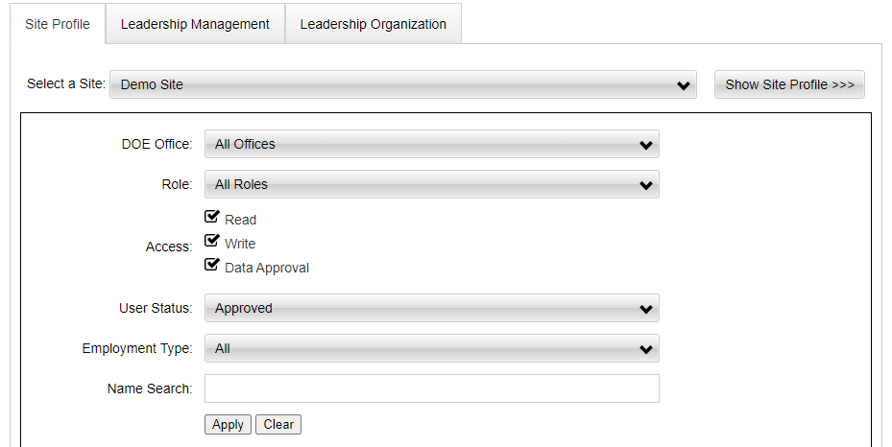
Approvals and User Access Updates
If you’re a site manager, take some time to review the users with access to your site’s data.
Also review the users with approval authority to ensure they are correct.

Slide 8
Changing Access and New Users
To make any changes to user access please email sustainability@hq.doe.gov.
Reminder: new users must request access and be approved by Program Office leads.

Slide 9
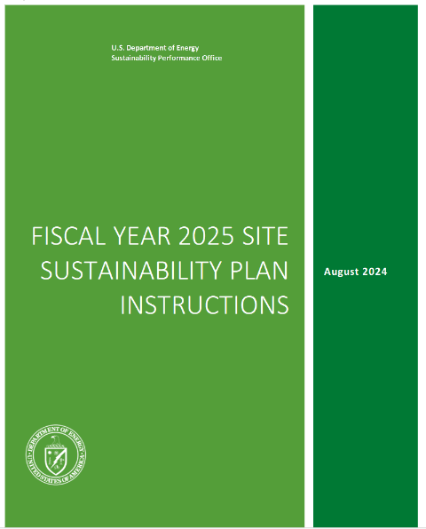
FY 2025 Site Sustainability Plan (SSP) Instructions
The FY 2025 SSP Instructions include focus areas to meet E.O. 14057 priorities:
Net-Zero Emission Buildings (NZEB) goals will be integrated in the Energy Management SSP category. Three tables have been updated to capture electrification efforts.
CFE goals have been integrated in the Clean & Renewable Energy SSP category.
Site Fleet Management efforts and ZEV goals have been added to the Fleet Management SSP category.

Slide 10
SSP Narrative Instructions
Under Current Performance (Briefly answer the category specific bullets and the below content):
When answering each category specific bullet include major initiatives, projects, or changes to missions or facilities in FY 2024 that impact performance in each category. Include relevant savings (e.g., energy savings, water savings, waste reduction, cost savings), cost of implementation, challenges, obstacles, solutions, and lessons learned.
Under Plans and Projected Performance (Recommended length 3-5 sentences):
Address major planned activities (e.g., mission changes, projects, new construction, major renovation, deactivation and decommissioning, procurement strategies, and policy and procedures updates) and expected impact. Quantify when possible.
Discuss challenges and obstacles, include possible solutions and requests & needs for technical assistance. If a goal area has a high or medium risk of non-attainment, as assigned in the executive summary table (optional), describe the rationale by type of risk(s).

Slide 11
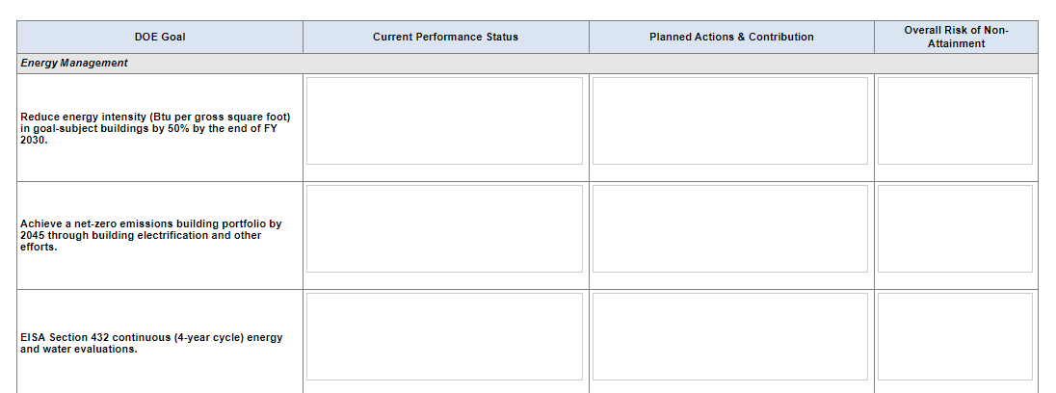
Executive Summary
SSP Narrative:
The executive summary should be a concise paragraph. Briefly discuss successes, and challenges - including investments that improve mission performance and result in significant efficiency and sustainability gains.
In addition to the executive summary narrative, there is an optional executive summary table in the Dashboard’s SSP Executive Summary category where sites can highlight progress and challenges towards meeting goals.

Slide 12
Energy Management
SSP Narrative:
Within the Energy Management section of SSP, include a subsection with a focus on NZB.
Use the three fillable tables in the SSP narrative section for sites to list construction of new electric facilities, electrification of existing facilities, and deep energy retrofits.

Slide 13
Energy Management
Data submission:
To support CFE tracking efforts, utility provider, balancing authority, grid mix and other fields have been added to the Dashboard’s Energy module to report on a utility provider’s energy source mix. These fields are intended to calculate site CFE progress and standard reports will be created to help track CFE and renewable energy progress to minimize data calls.
SPO is working to make enhancements to the energy module of the dashboard to better track electricity use from electric vehicle charging.
Hydrogen has been added as a fuel in the Energy and Non-Fleet Vehicles and Equipment categories.

Slide 14
Water Management
SSP Narrative
Briefly describe initiatives to reduce potable and non-potable water consumption, comply with stormwater management requirements, and improve water efficiency. In addition, summarize any obstacles related to the implementation of conservation strategies or the collection of water consumption data. Address the following key topic areas:
Initiatives, projects, or actions that impact water use and/or conservation. Quantify where possible.
Water management procedures, including:
Use of alternative water to offset the use of fresh surface and groundwater sources.
Evaluations and conservation measures, metering and benchmarking, optimization of systems, and operations and maintenance practices, including any measures identified in your site’s water assessment. Include timelines for implementation where possible.
Landscape management practices to reduce stormwater runoff and minimize water use.
Alternative water includes gray water, harvested rainwater, reclaimed water, process discharge water.

Slide 15
Fleet Management
SSP Narrative:
Use a subsection to describe the site fleet management program and policies on procurement, utilization, disposition, and mission support.
Sites to address new SSP Instructions bullets on:
Fleet management organizational structure and contact info.
Mission changes that will impact fleet.
Vehicle use policies and procedures.
Progress towards optional fleet profile as prescribed by June 2021 Vehicle Allocation Methodology (VAM).
Zero Emission Vehicle (ZEV) and Electric vehicle service equipment (EVSE) strategies and plans.
Fleet inventory projections and opportunities/challenges to install EVSE.
Site Fleet Management Information System (FMIS)

Slide 16
Clean and Renewable Energy
SSP Narrative:
Two fillable tables have been added to the SSP narrative section for sites to list CFE projections and planned onsite CFE projects.
Metric |  | FY 24 | FY 25 | FY 26 | FY 27 | FY 28 | FY 29 | FY 30
1 | Total annual CFE (a+b+c+d)
a | Grid-supplied CFE
b | Onsite CFE
c | Purchased CFE
d | Legacy CFE from EPAct 7.5% cap
2 | Total annual electricity usage
Onsite CFE system type (solar, wind, etc.) | Nameplate Capacity (MW) | Funding source(s) (appropriations, performance contract, AFFECT, etc.) | Estimated Year of Completion

Slide 17
Acquisition and Procurement
SSP Narrative:
Briefly describe the incorporation of all relevant sustainable acquisition clauses and recent sustainable purchases. Address the following key topic area:
Efforts to maximize sustainable acquisition of products, including DOE’s Priority Products List).
Reminders
If utilizing the workbook(s) for supplementary reporting, upload them to the SSP Acquisition & Procurement module as a supporting document. The Biobased Product Purchases Workbook is due by October 23, 2024, and the Sustainable Acquisition Contracts Workbook is due by November 22, 2024.

Slide 18
Investments: ECMs + Workforce and Community
SSP Narrative:
Please use the fillable table to list progress in implementing life cycle cost effective ECMs accomplished via performance contract.
Discuss any anticipated technical assistance needs (technical, procurement, etc.).
Describe any approved FY appropriations, AFFECT funds, and/or direct and indirect obligations for ECMs, including facility surveys/evaluations.
Actions taken to incorporate and/or expand environmental justice into operations, planning, decision making, and procurement activities.
Performance Contract Type (ESPC, UESC, or ENABLE) and Status | Project Title and Description | Estimated Energy Savings (BTU) | Expected GHG Reduction (MTCO2e) | Expected Project Value (all funding sources) | Anticipated TA Needs | Expected Award Date

Slide 19
Fugitives and Refrigerants
SSP Narrative:
Briefly discuss efforts to reduce GHGs from fugitive emissions and refrigerants. Address the key topic areas:
Inventory management, monitoring and control techniques, capture systems and storage equipment, leak detection and repair, and preventive maintenance programs to minimize releases.
Description of substitution and phasedown efforts (e.g., sulfur hexafluoride (SF6), hydrofluorocarbons (HFC)). Include SF6 and HFC material substitution and usage reduction efforts:
Response to HFC Phasedown for continued HFC procurement.
HFC alternatives including materials researched, considered, and implemented.
Lessons learned and best management practices for substituting and reducing HFC.

Slide 20
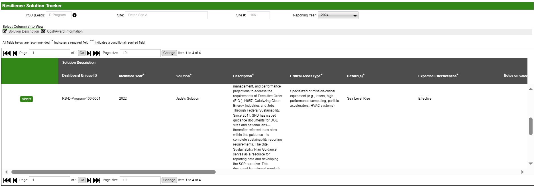
Climate Adaptation & Resilience
Data Entry:
Add new resilience solutions and update the status of existing resilience solutions and in the Dashboard’s Resilience Solution Tracking module by the November 22nd reporting deadline.

Slide 21
Climate Adaptation & Resilience
SSP Narrative:
Briefly describe efforts to increase site adaptation and resilience to address the impacts of climate change. Address the following key topic areas:
Describe your site’s process to quantify damages from extreme weather events.
Provide an update on the implementation of resilience solutions reported in your site’s Vulnerability Assessment and Resilience Plan (VARP) and the Dashboard module. Also describe the anticipated effectiveness of measures. Update the Dashboard’s Resilience Solutions Tracking module accordingly.
Provide an update on the cost of implementing your site’s resilience solutions, including budget coordination and planning, lifecycle cost, return-on-investment, and financing strategies.
Describe efforts to improve climate literacy across the workforce and describe your site’s internal climate literacy training efforts. If your site does not have its own internal training, describe the distribution of SPO’s Climate Change 101 (CLI101) course available on Learning Nucleus. Include barriers to distribution and if CLI101 is hosted on a Learning Management System other than Learning Nucleus, include how many people have taken the training.

Slide 22
Optional SSP Sections
Reminder
These sections have been cut from these instructions to streamline reporting. Sites must still submit data for these categories by the November 22nd reporting deadline. Inclusion of a narrative for these categories within SSP section of the Dashboard is not required.
Waste
Sustainable Buildings
Indirect Emissions
Electronic Stewardship and Data Centers

Slide 23
Reporting Resources
Dashboard’s Supporting Resources Page
Short Dashboard tutorial videos can be found under the Training Files section. SPO recommends viewing the Site Sustainability Plan Module and QA/QC and Change Request videos for more information on submitting data and SSPs.
A requirements matrix can be found on the Statutes SSP section.
Biobased and Sustainable Acquisition Contracts Workbooks are within the Reporting Files section.

Slide 24
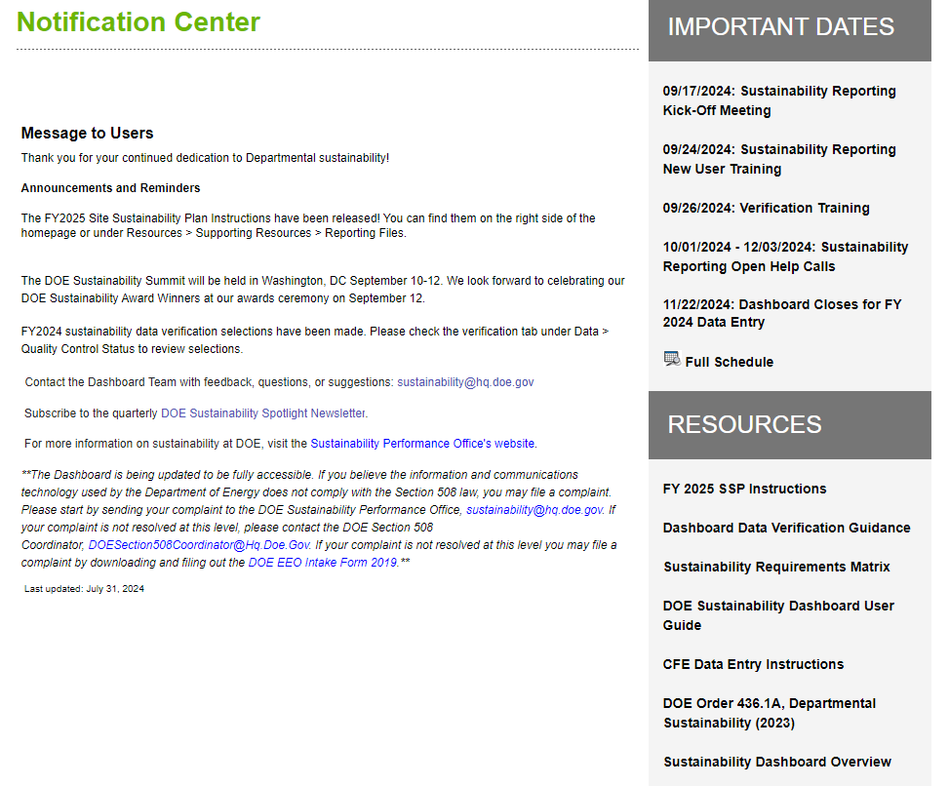
Dashboard Updates – User Guide
Dashboard User Guide Version 1.4
Version 1.4 of the Dashboard User Guide will be published later in September.
You can find this on the homepage of the dashboard in the Resources section on the bottom right of the screen.

Slide 25
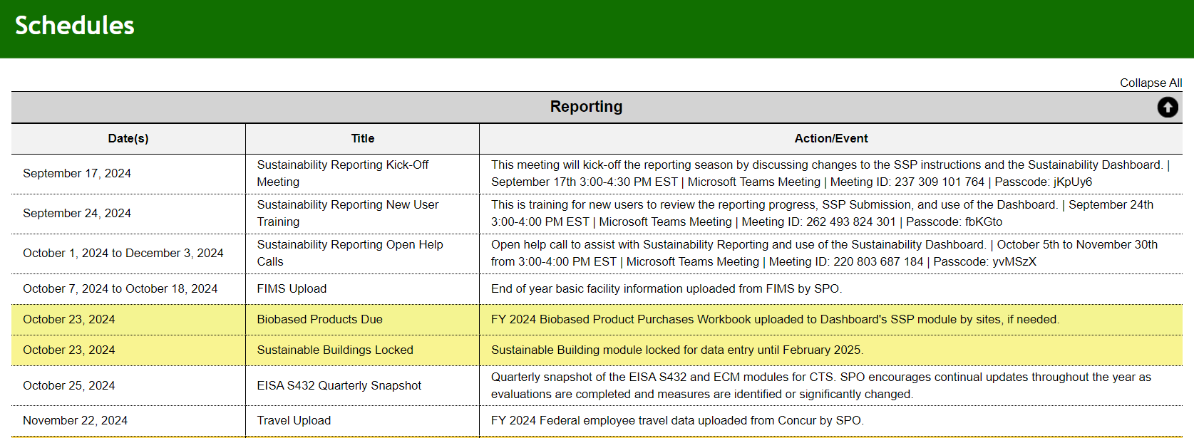
Dashboard Updates – Schedules
Dashboard’s Schedules Page
The Schedules page has been updated with updated FY 2024 - 2025 reporting dates.
New user training scheduled for September 24th.
Calendar invites for can be downloaded from the Schedules page.

Slide 26
Contact us
Thank you in advance for preparing the SSPs!
If you have any questions, send us an email at sustainability@hq.doe.gov.

