Slide 1
Annual Sustainability Reporting Kick-Off
September 22, 2026

Slide 2
Annual Reporting
  Sites are required to use the Energy and Water Dashboard to report data and narratives to meet statutory energy and water requirements.
  Site collected data and narratives from October 1, 2025 to September 30, 2026 are compiled to form DOE’s FY 2026 Annual Energy Report (AER).
  Site Energy and Water narrative instructions have been distributed to Programs and are posted to the Dashboard. Like the previous year, sites only need to provide a supporting narrative description if their data changes by 5% from the previous year.
  Key sections of the Dashboard User Guide have been updated and are posted on the Dashboard homepage and within the Supporting Resources module.

Slide 3
Key FY27 Reporting Dates
Date | Item Due | Corresponding Modules
October 2026 | FIMS facility information uploaded to the Dashboard | FIMS data feeds into the following modules: Facility Goal Category, Metering, Sustainable Buildings, New/Major Renovation Building Design, EISA S432 Evaluations
October 23, 2026 | Optional Biobased Product Purchases Workbook | Upload workbooks to the Dashboard’s Acquisition and Procurement narrative section.
November 20, 2026 | Dashboard data for required categories due. | Energy Water On-Site Renewable Generation Systems Purchased Renewable Energy Sustainable Buildings Facility Goal Category – If you have excluded buildings, upload the Excluded building Self Certification letter to the Completion Status module. Facility Metering Status Appropriations/Direct Obligations Training & Education Non-Fleet Vehicles and Equipment Fugitives and Refrigerants Municipal Solid Waste Wastewater Treatment
November 20, 2026 | Energy and Water Narratives due | The below narratives are due to the corresponding Narrative modules if data fluctuates by 5% from 2025: Energy Management Water Management Renewable Energy Investments: Facilities & Workforce
November 20, 2026 | Optional Data Accuracy Self-Certification document Optional Sustainable Acquisition Contracts workbook. | If you do not use the Dashboard approval process, upload the Data Accuracy Self-Certification document to the Completion Status module. Upload optional workbooks to the Acquisition and Procurement narrative section.
March 31, 2027 | EISA Evaluations, Efficiency & Conservation Measures, and Benchmarking data. | Report EISA Evaluations and Efficiency & Conservation Measures to the corresponding modules. Benchmarking data due to Portfolio Manager.

Slide 4
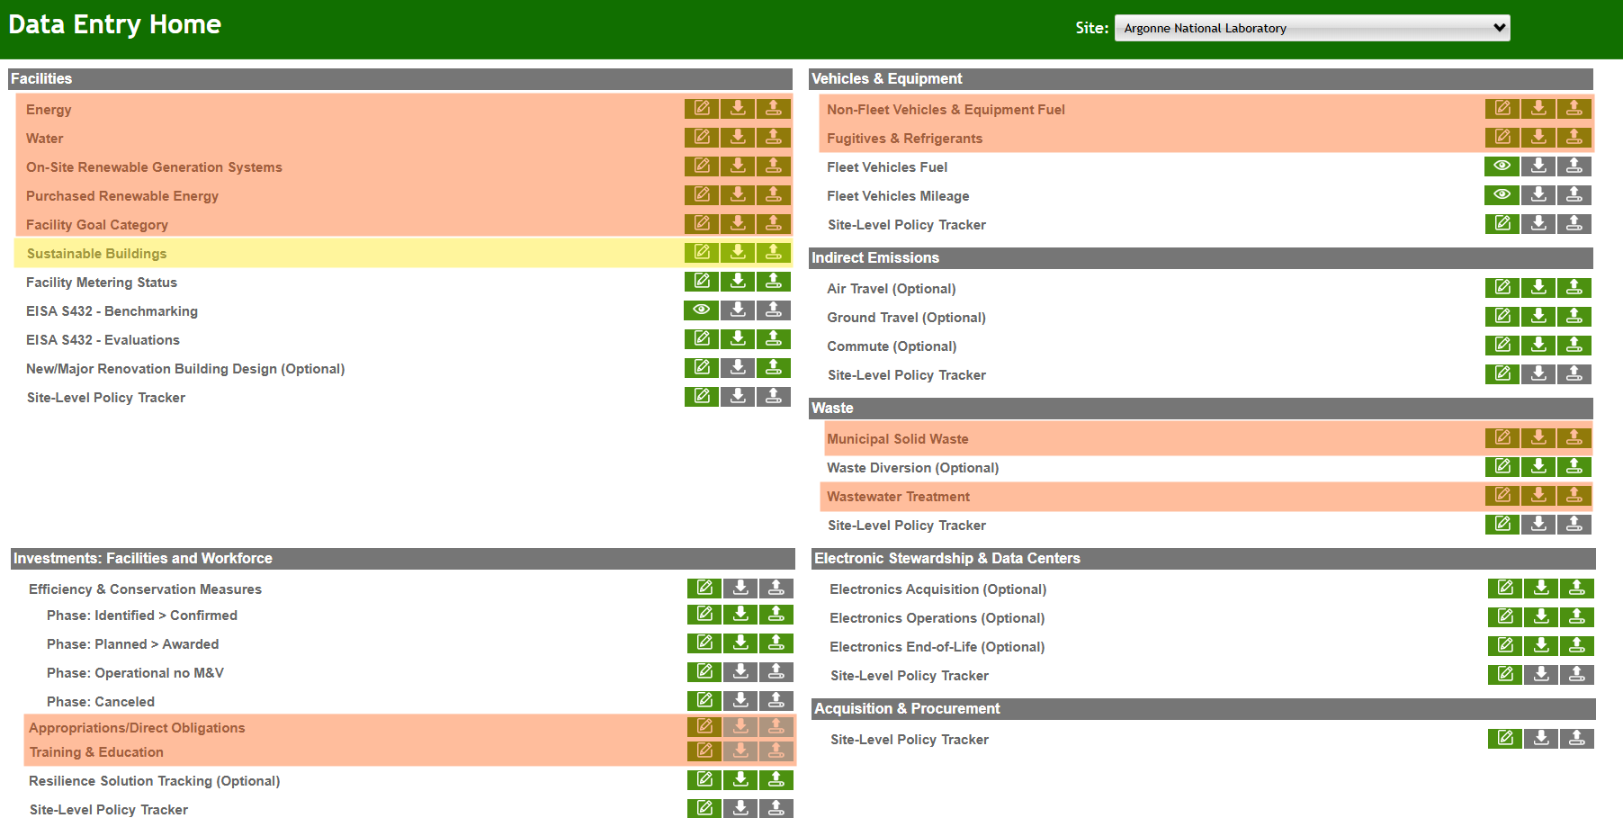
November 2026 Reporting Deadlines
The highlighted modules are due on November 20, 2026.

Slide 5
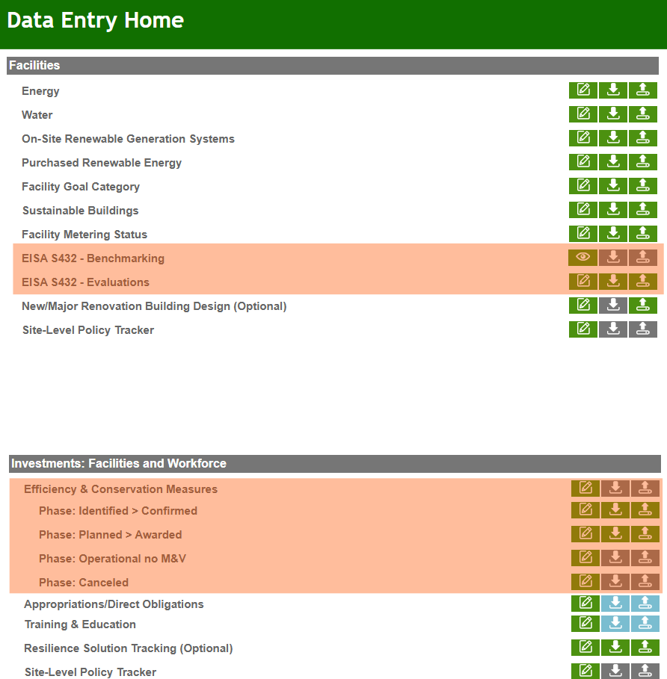
March 2027 Reporting Deadlines
The highlighted modules are due on March 31, 2027.
These modules capture annual data rather than fiscal year data. Before sites can report on these modules, the reporting year needs to role over to 2027. This happens in January 2027.
Data reported to the highlighted categories are not used to formulate the AER but instead inform EISA S432 reporting which is due to FEMP’s Compliance Tracking System in June 2027.

Slide 6
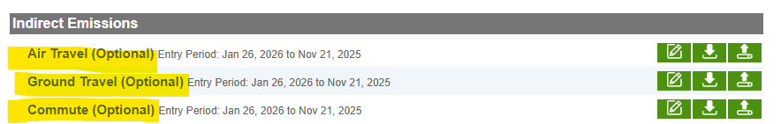
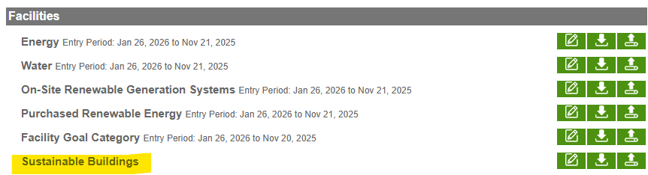
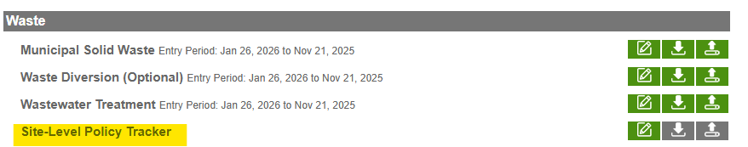
Data Entry – Optional Categories
There are several optional categories indicated by “(Optional)”.
The Sustainable Buildings module only requires updates if the Dashboard data does not match FIMS. The data in FIMS is the source of truth for Sustainable Buildings data, and data from FIMS is reported out to GSA.
Site-Level Policy Tracker sections provide a space for sites to add policies. This information is not required.

Slide 7
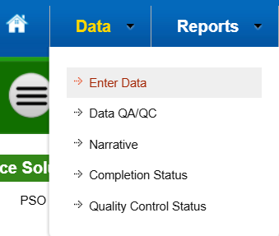


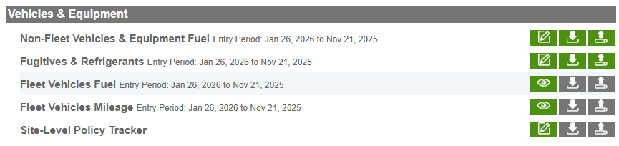
Data Entry - Functions
Enter data under Data allows for entry of current year information via:
Direct entry
Bulk upload by downloading and uploading a template
The eye icon represents read only data. There are currently some issues with these modules, so the data within these modules is not current/pulling.

Slide 8
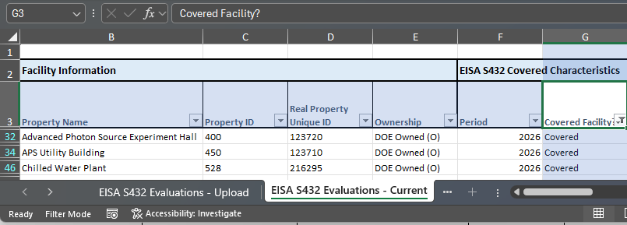
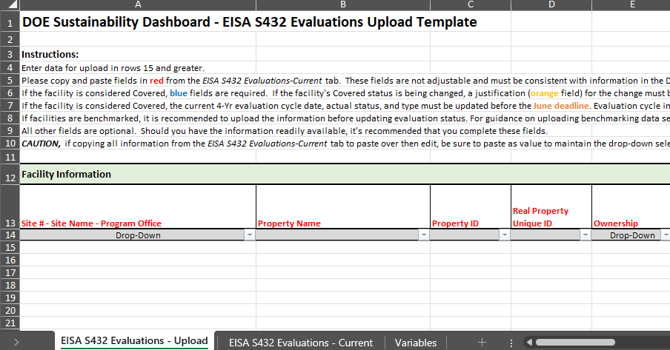
Data Entry- Templates
Modules can be updated through an Excel format templates.
Each template has specific data entry instructions.
  It can be helpful to refer to the respective Dashboard category to understand how the template maps to the Dashboard.
  Some templates utilize a current and an upload tab format. To update data, copy and paste data from the current tab to the upload tab and make any changes before uploading.

Slide 9




Data Entry – Save & Complete
In addition to capturing data, each category allows for:
Saving of the data without submission.
Inclusion of optional supporting documents.
Review of entry before completion to ensure accuracy.
Correction of historical information.
Completion of data for approval and submission.
  Note: Ensure the data is correct and final before pressing complete to avoid having to reach out to sustainability@hq.doe.gov to unlock the module.

Slide 10
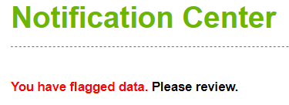
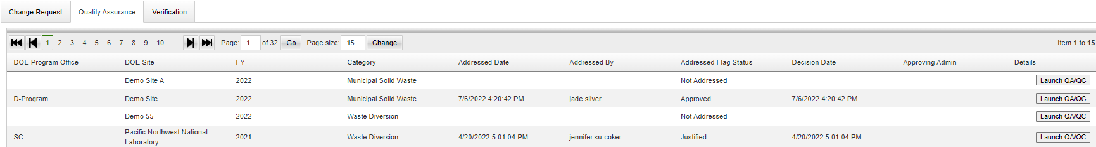
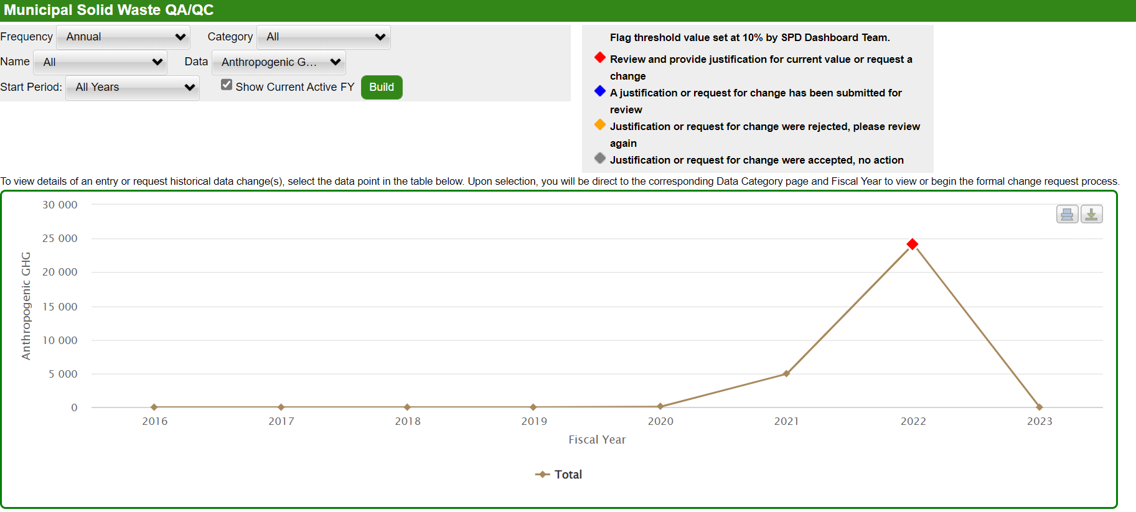
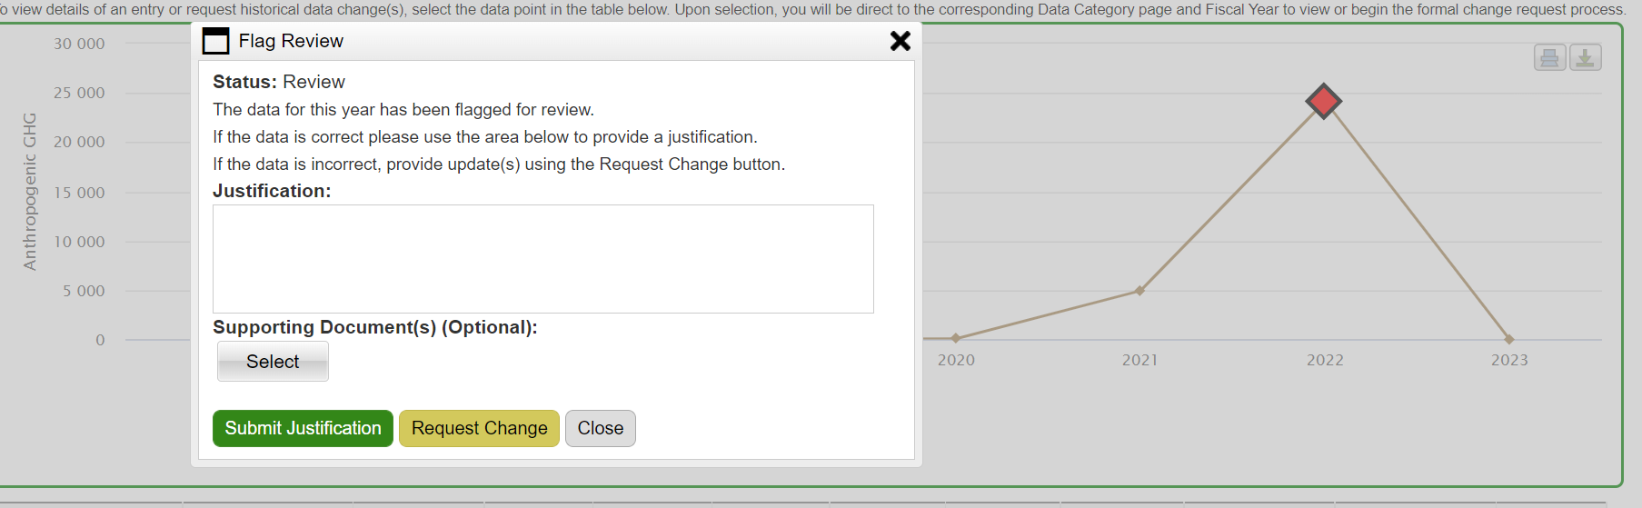
Quality Assurance (1 of 2)
Review and address system generated flags:
Click the Please Review on the Home page
Address flagged data by providing a justification or correcting the data by clicking Launch QA/QC.

Slide 11
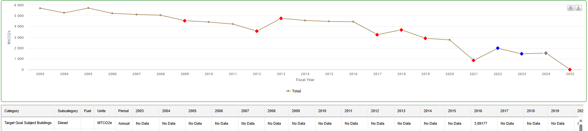
Quality Assurance (2 of 2)
QA/QC graphs can be adjusted to visualize trends. It is recommended you start by viewing the data in native units. Ensure you hit the “build” button so your graph reflects changes.

Slide 12
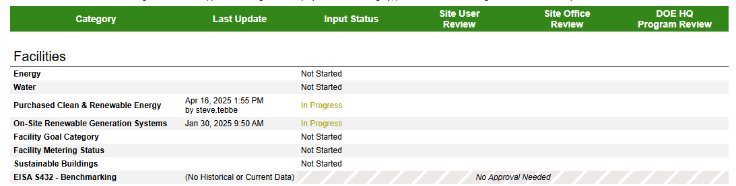
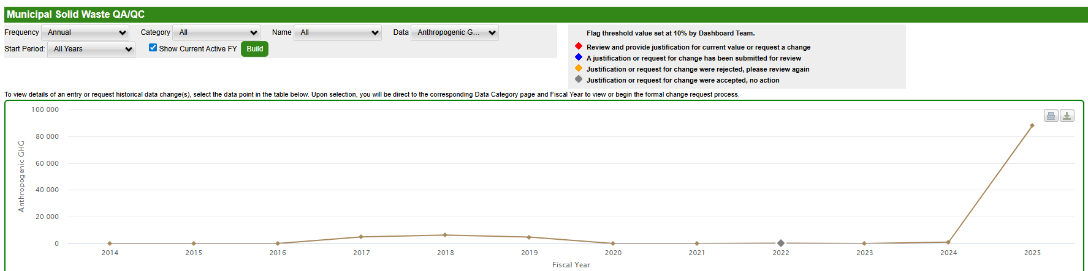
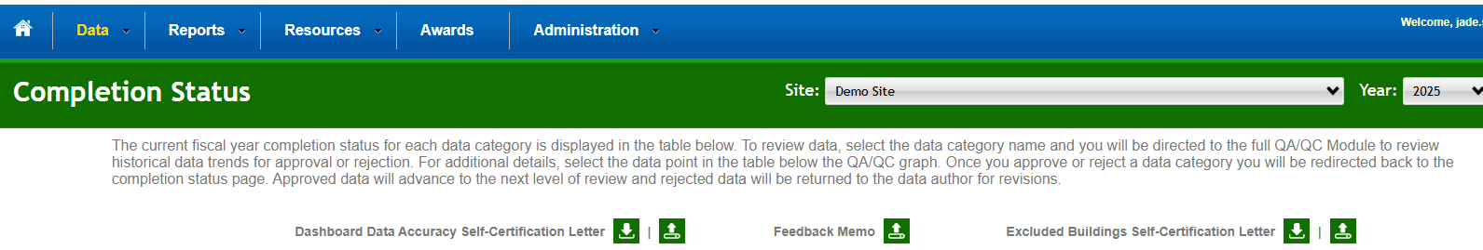
Completion Status Page
The Completion Status provides an overview of the data input and approvals for each data module.
By clicking on the data category name, users will be taken to a QA/QC graph.
  Note: Purchased and Onsite RE graphs are not operational.
If utilizing the Optional Plan Signature Document or the Excluded Buildings Self Certification Letter, upload documents to the top of the Completion Status page.

Slide 13
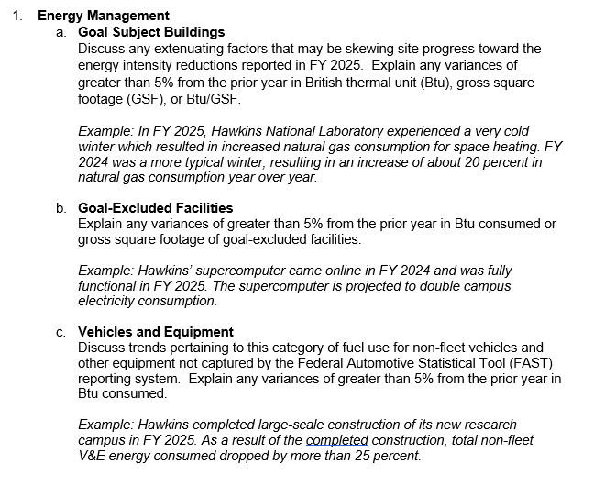
FY 2027 Energy & Water Narrative Instructions
FY 2027 instructions focus on information needed to complete statutory reporting.
Sites are only required to fill out Energy Management, Water Management, and Renewable Energy narrative sections if the reported year over year data fluctuates by more than ±5%.
Sites are only required to fill out the Investments: Facilities and Workforce narrative if you have a relevant project (e.g., ESPC, UESC, AFFECT). Please note, that the instructions this year for differ slightly from last year.
Narratives must be submitted through the Dashboard using the corresponding section of the narrative category.
Optional narrative sections include: Executive Summary, Waste Management, Fleet Management, Sustainable Buildings, Acquisition & Procurement, Indirect Emissions, Fugitives & Refrigerants, Electronic Stewardship & Data Centers, and Adaptation & Resilience

Slide 14
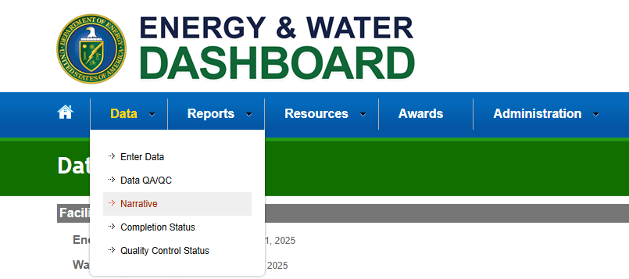
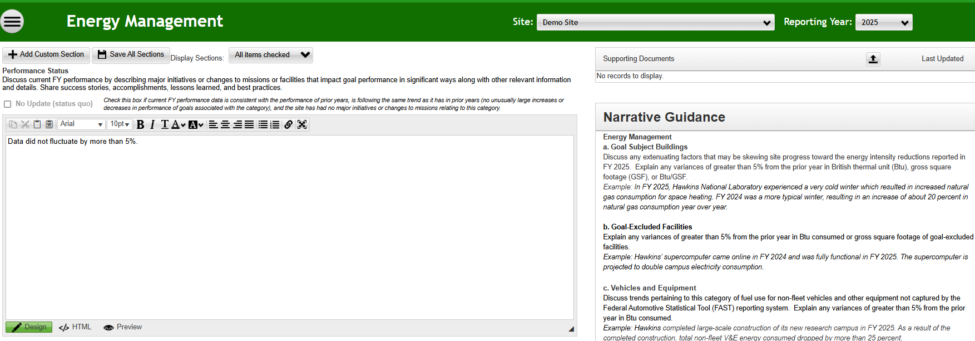
Energy & Water Narrative Overview
Energy and Water Narratives capture the story behind annual data submission.

Slide 15



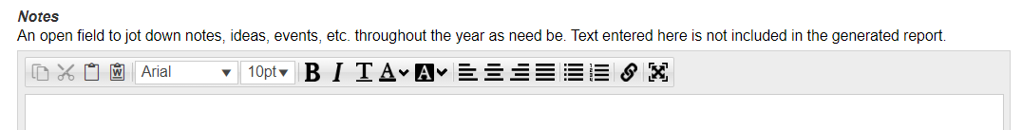
Narrative Functions
The narrative module key capabilities consist of:
Direct entry and ability to save for later
Work offline by using the upload template
Jot down notes throughout the year without it being part of the generated plan.

Slide 16
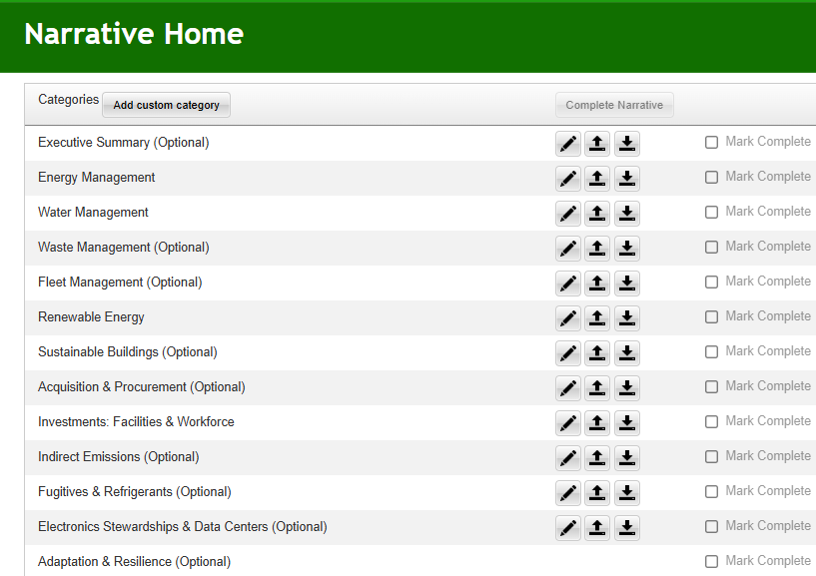

Optional Energy and Water Narrative Sections
The following sections are “optional” for Narrative reporting and have been indicated as such in the narrative section of the Dashboard:
Executive Summary
Waste Management
Fleet Management
Sustainable Buildings
Acquisition & Procurement (optional workbooks should be uploaded to this page)
Indirect Emissions
Fugitives & Refrigerants
Electronic Stewardship & Data Centers
Adaptation & Resilience

Slide 17
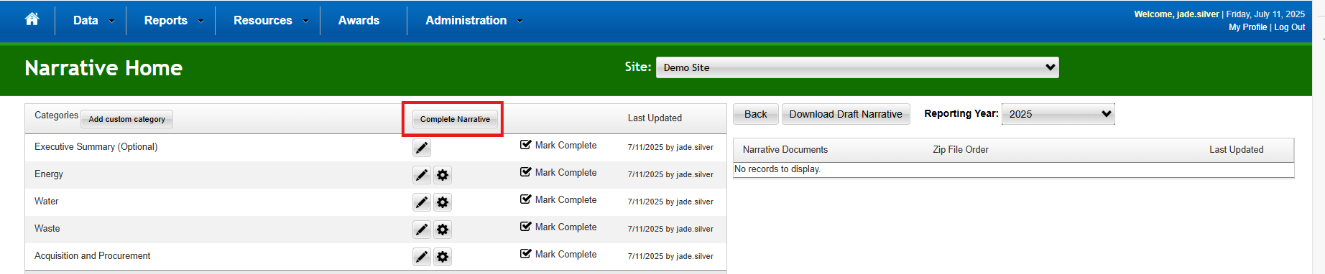
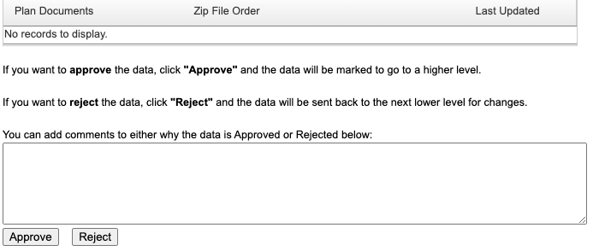
Completing the Narrative
Once you have checked the “Marked Complete” box for required narrative categories, you will be able to select the “Complete Narrative” button. If you have the responsibility for approval, you will then have the option to “approve” or “reject” the narrative (on the right-hand side). The narrative can also be approved via the Completion Status page.
  The Dashboard has been modified so only Energy, Water, Renewable Energy, and Investments: Facilities and Workforce categories need to be marked as complete to complete the entire Energy and Water narrative.

Slide 18
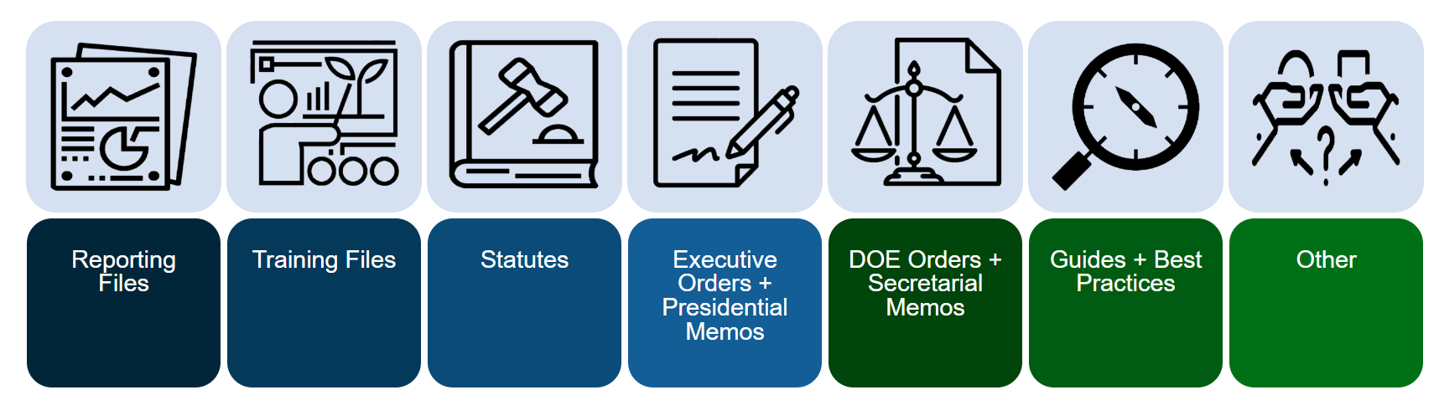
Supporting Resources
Users are encouraged to browse the Supporting Resources Dashboard section to assist with reporting.
  The Reporting Files section includes:
    Biobased and Sustainable Acquisition Contracts Workbooks
    A Requirements Matrix, Reporting Requirements Crosswalk, and Energy and Water Goals Table to assist in understanding goals and requirements.
  The Training Files section includes:
    Short tutorial videos (e.g., Narrative, QA/QC, Change Requests) on submitting data and the narrative. Please note that some resources such as the Site Sustainability Plan Module have not been updated to reflect narrative name changes and optional reporting categories.

Slide 20
Narrative Questions
Question: If my data has not changed by more than 5%, do I need to write a narrative?
Answer: Please write a short note explaining that the data has not fluctuated by 5% or more. This will help reviewers know that the section has been completed.
Question: For multi-location sites, is the 5% explanation threshold by individual or combined sites (e.g. NNSS or SPR)?
Answer: You can apply the 5% to all sites rather than each individual site.
Question: When developing my narrative, should I separate my Target Goal Subject and Excluded Buildings?
Answer: Yes. Please keep these separate, and provided a narrative for both, if needed.

Slide 21
Narrative Questions
Question: Do we need to address flags in the Dashboard? What is the flagging threshold?
Answer: Yes, please address flags. The Dashboard flags data that has± 10% change from the previous year. The Dashboard flagging capacity helps users’ address possible errors in data.
Question: What is the rational of justifying fluctuations that ± 5% in the narrative?
Answer: The narrative instructions mimic FEMP’s Annual Energy Report narrative and will be used to help DOE understand factors driving Departmental data changes.

Slide 22
Reporting FAQs: Sustainable Buildings
Question: What are the requirements for Sustainable Buildings?
Answer: DOE O 413.3C no longer includes the previous 25,000 GSF High Performance Sustainable Buildings (HPSB)/Guiding Principles requirement. DOE O 430.1C requires sites to report sustainable building status through FIMS. Although DOE O 430.1C references 5,000 GSF, the Order is intended to align with current FIMS and Federal Real Property Portfolio guidance, which has a reporting threshold of 25,000 GSF.
HPSB data reported in the Dashboard should match FIMS. If discrepancies are identified, sites should work with the Dashboard Administrator to resolve them.

Slide 23
Reporting FAQs: Excluded vs Non-Covered Buildings
Question: What is the difference between goal subject/excluded buildings and covered/non-covered buildings?
Answer: Goal Subject and Excluded buildings pertain to energy efficiency goals. FEMP exclusion guidance lists reasons when a building can be excluded (e.g., High Energy Mission Specific Facilities (HEMSF)). Energy from excluded buildings is excluded from Departmental energy reduction goals.
Covered and Non-Covered buildings pertain to EISA §432 reporting. Sites designate facilities that consume 75% of the site's total energy as covered and conduct audits on these facilities. Non‑covered buildings are the remaining 25% of buildings. These buildings are not required to be audited under EISA §432. If a building is excluded from energy reduction goals, it does not mean that it is a non-covered building. Many times, HEMSFs are EISA covered buildings, since these buildings are needed to get the site to a status of 75% covered.

Slide 24
FAQs: EUI and WUI
Question: How is Energy Use Intensity (EUI) Calculated?
Answer: EUI = Total Goal Subject Energy Use (from the Energy module + Purchased Green Energy) ÷ Total Site Goal Subject Sqft
Question: How is Water Use Intensity (WUI) Calculated?
Answer: WUI = Annual Potable Water Use ÷ Total GSF – Non Water Consuming SqFt.

Slide 25
FAQ: Sustainable Acquisition and Biobased Products
Question: When and how do I use the Sustainable Acquisition Contracts Workbook?
Answer: For FY26 reporting, the workbook is optional, but sites are welcome to complete and submit the workbook. All service and construction contract actions that cannot be reported in the Federal Procurement Data System (FPDS) should be reported in the Sustainable Acquisition Contracts Workbook. Do not submit twice. Please work with your site's Contracting Officer to ensure FPDS is not already being utilized.
Question: When do I use the Biobased Product Purchases Workbook?
Answer: For FY26 reporting, the workbook is optional, but sites are welcome to complete and submit the workbook if your site is unable to submit the data in sam.gov. Please work with your site's Contracting Officer to ensure the data is not being submitted in sam.gov.
If you have any product-related questions, please reach out to Shab Fardanesh in EHSS-ENV at shabnam.fardanesh@hq.doe.gov

Slide 26
FAQ: Renewable Energy Requirements
Question: Are there any requirements for RECs if we buy RECs to cover the 7.5% renewable requirements?
Answer: The requirements are as follows:
The generator must meet the definition of renewable in statute 42 U.S.C.§15852.
RECs must be generated by facilities placed in service within 15 years prior to the start of the reporting fiscal year.
RECs must be produced six months prior to the beginning of the fiscal year through three months after the end of the fiscal year. For RECs to count in FY 2026 reporting, they must have been produced between April 1, 2025, and Jan. 1, 2027.
The provider should send attestation documentation with the type of generation, generator’s ZIP code and placed in service date, generation date, etc.
Third-party certification (e.g., Green-e) is recommended as a best practice to ensure that the RECs are not being double counted.

